Slide 1
Animal Species Detection
Group members:
Arjumand. (2021a1r111)
Emrinder Singh. (2021a1r108)
Ankush Singh Langeh. (2021a1r115)
JattanVir Singh Bhutyal. (2022a1l013)

Slide 2
Problem Statement
How can we use AI to revolutionise conservation efforts of wild animals.
Animal image classification is a complex task that involves using artificial intelligence (AI) algorithms to identify and categorize animals based on their visual characteristics.

Slide 3
Proposed Solution
As already discussed that the classification of animals is a complex task so we can make use of AI with Computer Vision to accomplish this.
This technology has numerous applications, including wildlife conservation, veterinary medicine, and even agriculture. With the advent of deep learning and computer vision technologies, it is now possible to develop highly accurate and efficient animal image classification systems that can analyze millions of images in real-time

Slide 4
Proposed Solution
One of the primary challenges in animal image classification is dealing with the vast amount of visual data that is available. This data can be highly diverse, ranging from low-quality camera trap images to high-resolution photos captured by professional photographers.
Additionally, the appearance of animals can vary significantly depending on factors such as age, sex, and location. To overcome these challenges, researchers often rely on deep learning models that can learn from large datasets and generalize well to new images.

Slide 5
Training The Model
The model images will be subjected to a CNN model called EfficientNetB7. Three callbacks will be utilized to monitor the training. These are: Model Checkpoint, Early Stopping, Tensorboard callback. The summary of the model hyperparameter is shown as follows:
Batch size: 32 Input Shape: (224, 224, 3) Epochs: 100 Output layer: 10

Slide 6
About Dataset
For Dataset we have referred to kaggle for animal pictures to train the model.
The dataset contains photos of animals from 10 different categories.
The dataset contains about 28K medium quality animal images belonging to 10 categories: dog, cat, horse, spyder, butterfly, chicken, sheep, cow, squirrel, elephant.

Slide 7
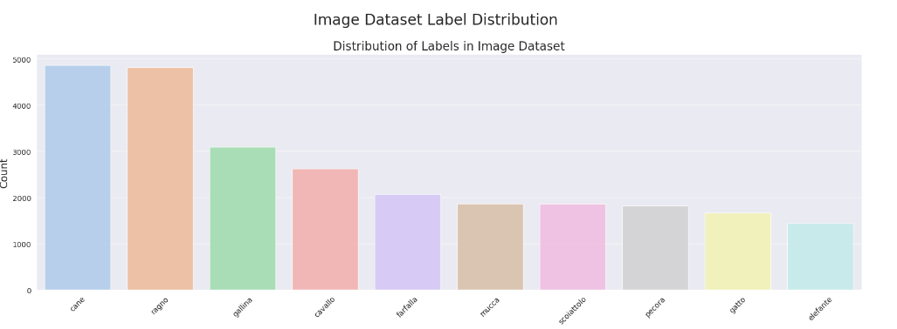

Slide 8
Error Rate Analysis
The `compute_ela_cv()` function compresses an image at a specified JPEG quality, computes the absolute difference between the compressed and original images, and returns an ELA image after scaling the difference.
The `convert_to_ela_image()` function also compresses an image at a specified JPEG quality, calculates the absolute difference between the compressed and original images, normalizes the difference, and returns the resulting ELA image.

Slide 9
Error Rate Analysis
The `random_sample()` function selects a random file path from a specified directory, optionally filtering by file extension.
The code generates ELA images for a randomly chosen test animal image at various JPEG quality levels, showing increasing error with more compression. These images are displayed using matplotlib, providing a visual analysis of JPEG compression effects, useful for determining optimal compression quality for animal image classification tasks.

Slide 10
Data PreProcessing
The data will be split into three different categories: Training, Validation and Testing.
The training data will be used to train the deep learning CNN model and its parameters will be fine tuned with the validation data.
Finally, the performance of the data will be evaluated using the test data(data the model has not previously seen)

Slide 11
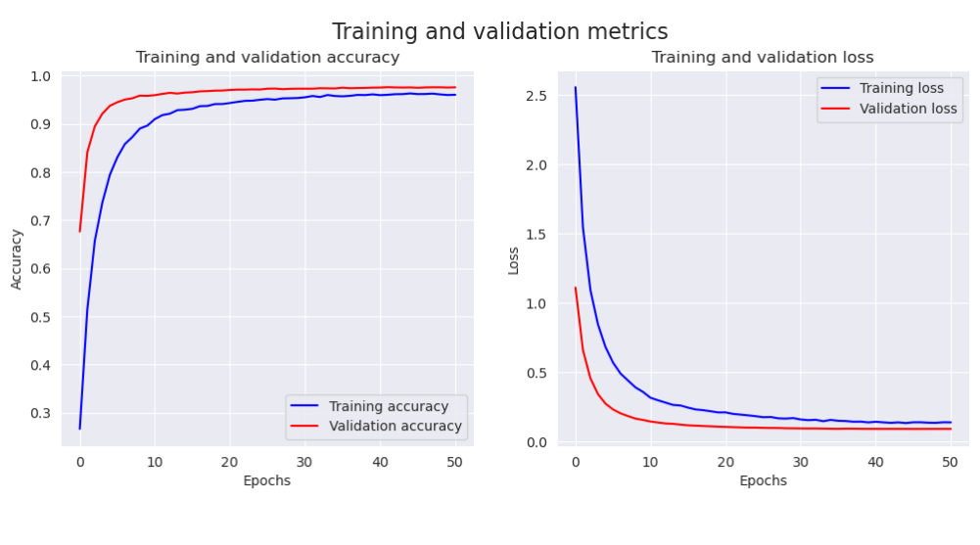
Accuracy Of The Model

Slide 12
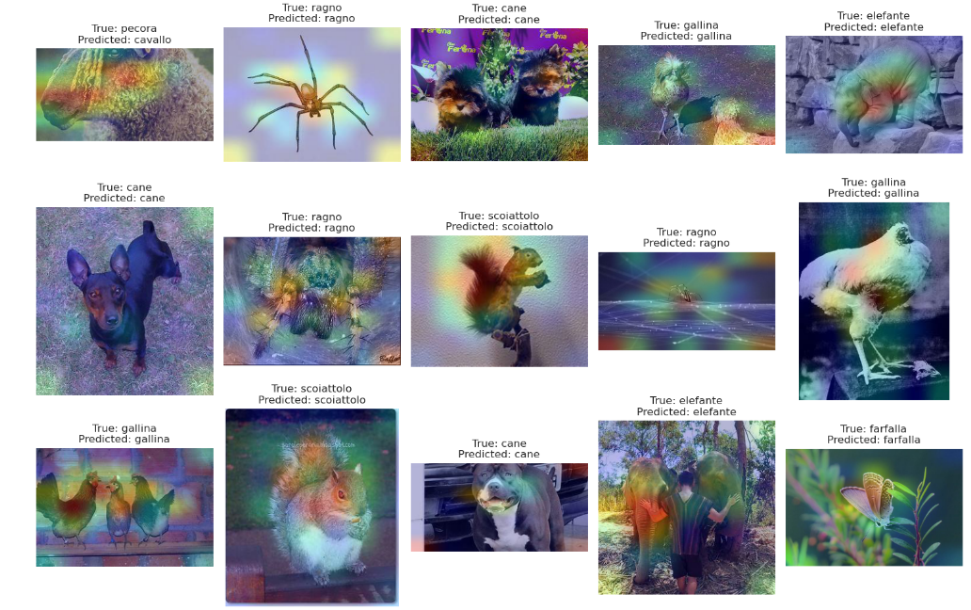

Slide 13
Thanks

